Slide 1


http://www.comp.nus.edu.sg/~cs2100/
Recitation 10
Sequential Circuits
(Aaron Tan)

Slide 2
Agenda
Quick Summary
Latches
Flip-flops
Analysis of Sequential Circuits
Design of Sequential Circuits
Solutions to Recitation 10 Quizzes
Sli.Do Questions
Extra Questions

Slide 3
1. Introduction (1/2)
Two classes of logic circuits
Combinational
Sequential
Combinational Circuit
Each output depends entirely on the immediate (present) inputs.
Sequential Circuit
Each output depends on both present inputs and state.
Combinational
Logic
Combinational
Logic
inputs
: :
: :
outputs
inputs
: :
: :
outputs
Memory

Slide 4
summary
Latches

Slide 5
3.1 S-R Latch (2/3)
Active-high input S-R latch:
1
0
1
0
0
R
1
1
0
0
Q
0
Q'
0
0
1
1
1
0
0
0
0
1
S
Block diagram:
Characteristic table:
S
R
Q
Q'

Slide 6
3.1 Active-Low S-R Latch
(You may skip this slide.)
What we have seen is active-high input S-R latch.
There are active-low input S-R latches, where NAND gates are used instead. See diagram on the left below.
S
Q
S
Q
R
Q'
R
Q'
In this case,
when R=0 and S=1, the latch is reset (i.e. Q becomes 0)
when R=1 and S=0, the latch is set (i.e. Q becomes 1)
when S=R=1, it is a no-change command.
when S=R=0, it is an invalid command.
Sometimes, we use the alternative gate diagram for the NAND gate. See diagram on the right above. (This appears in more complex latches/flip-flops in the later slides.)
(Sometimes, the inputs are labelled as S' and R'.)

Slide 7
3.1 Active-High vs Active-Low S-R Latch
(Active-high) S-R latch
Active-low S-R latch
R
Q
R
Q
S
Q'
S
Q'
S | R | Q(t+1) | Command
0 | 0 | Q(t) | No change
0 | 1 | 0 | Reset
1 | 0 | 1 | Set
1 | 1 | ? | Invalid
S | R | Q(t+1) | Command
1 | 1 | Q(t) | No change
1 | 0 | 0 | Reset
0 | 1 | 1 | Set
0 | 0 | ? | Invalid

Slide 8
3.1 Gated S-R Latch
S-R latch + enable input (EN) and 2 NAND gates → a gated S-R latch.
S
Q
S
EN
R
Q
Q'
EN
Q'
R
Outputs change (if necessary) only when EN is high.
Characteristic table:
EN | S | R | Q(t+1) | Command
1 | 0 | 0 | Q(t) | No change
1 | 0 | 1 | 0 | Reset
1 | 1 | 0 | 1 | Set
1 | 1 | 1 | ? | Invalid
0 | X | X | Q(t)

Slide 9
3.2 Gated D Latch (1/2)
Make input R equal to S' → gated D latch.
D latch eliminates the undesirable condition of invalid state in the S-R latch.
D
Q
D
EN
Q
Q'
EN
Q'
Characteristic table:

Slide 10
summary
Flip-Flops

Slide 11
4. Flip-flops (1/2)
Flip-flops are synchronous bistable devices.
Output changes state at a specified point on a triggering input called the clock.
Change state either at the positive (rising) edge, or at the negative (falling) edge of the clock signal.
Clock signal
Positive edges
Negative edges

Slide 12
4.1 S-R Flip-flop
S-R flip-flop: On the triggering edge of the clock pulse,
R = HIGH and S = LOW ➔ Q becomes LOW (RESET state)
S = HIGH and R = LOW ➔ Q becomes HIGH (SET state)
Both R and S are LOW ➔No change in output Q
Both R and S are HIGH ➔Invalid!
Characteristic table of positive edge-triggered S-R flip-flop:
S
C
R
Q
Q'
X = irrelevant (“don’t care”)
↑ = clock transition LOW to HIGH

Slide 13
4.2 D Flip-flop (1/2)
D flip-flop: Single input D (data). On the triggering edge of the clock pulse,
D = HIGH ➔ Q becomes HIGH (SET state)
D = LOW ➔ Q becomes LOW (RESET state)
Hence, Q “follows” D at the clock edge.
Convert S-R flip-flop into a D flip-flop: add an inverter.
D
S
C
R
Q
Q'
CLK
A positive edge-triggered D flip-flop formed with an S-R flip-flop.
↑ = clock transition LOW to HIGH

Slide 14
4.3 J-K Flip-flop (2/2)
J-K flip-flop circuit:
J
Q
Pulse transition detector
CLK
Q'
K
Characteristic table:
Q(t+1) = ?
J∙Q' + K'∙Q


Slide 15
4.4 T Flip-flop
T flip-flop: Single input version of the J-K flip-flop, formed by tying both inputs together.
T
T
Q
J
C
K
Q
Q'
Pulse transition detector
CLK
CLK
Q'
Characteristic table:
Q(t+1) = ?
T∙Q' + T'∙Q


Slide 16
5. Asynchronous Inputs (1/2)
S-R, D and J-K inputs are synchronous inputs, as data on these inputs are transferred to the flip-flop’s output only on the triggered edge of the clock pulse.
Asynchronous inputs affect the state of the flip-flop independent of the clock; example: preset (PRE) and clear (CLR) [or direct set (SD) and direct reset (RD)].
When PRE=HIGH, Q is immediately set to HIGH.
When CLR=HIGH, Q is immediately cleared to LOW.
Flip-flop in normal operation mode when both PRE and CLR are LOW.

Slide 17
5. Asynchronous Inputs (2/2)
A J-K flip-flop with active-low PRESET and CLEAR asynchronous inputs.
PRE
PRE
J
Q
J
C
K
Q
Q'
Pulse transition detector
CLK
K
Q'
CLR
CLR
CLK
PRE
CLR
J = K = HIGH
Q
Preset
Toggle
Clear

Slide 18
summary
Analysis of Sequential Circuits

Slide 19
6.1 Flip-flop Characteristic Tables
Each type of flip-flop has its own behaviour, shown by its characteristic table.

Slide 20
6.2 Analysis: Example #2 (1/3)
Given Figure 2, a sequential circuit with two J-K flip-flops A and B, and one input x.
J
Q
A
x
K
Q'
J
Q
B
K
Q'
Figure 2
CP
Obtain the flip-flop input functions from the circuit:
JA = B JB = x'
KA = B∙x' KB = A'∙x + A∙x' = A ⊕ x

Slide 21
6.2 Analysis: Example #2 (2/3)
JA = B JB = x'
KA = B∙x' KB = A'∙x + A∙x' = A ⊕ x
Fill the state table using the above functions, knowing the characteristics of the flip-flops used.
0 1
0 0
1 1
1 0
1 1
1 0
0 0
1 1


Slide 22
6.2 Analysis: Example #2 (3/3)
Draw the state diagram from the state table.
1
1
0
11
00
0
0
0
01
1
10
1


Slide 23
summary
Design of Sequential Circuits

Slide 24
6.3 Flip-flop Excitation Tables (1/2)
Excitation tables: given the required transition from present state to next state, determine the flip-flop input(s).
JK Flip-flop
SR Flip-flop
D Flip-flop
T Flip-flop

Slide 25
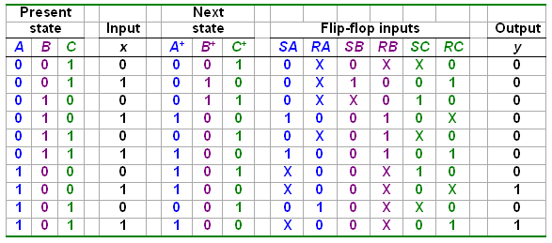
6.4 Design: Example #3 (1/4)
Design involving unused states.
Are there other unused states?
Given these
Derive these
Unused state 000:

Slide 26
6.4 Design: Example #3 (2/4)
From state table, obtain expressions for flip-flop inputs.
Cx
C
Cx
C
AB
00 01 11 10
AB
00 01 11 10
00
01
11
10
X
X
0
0
00
01
11
10
X
X
X
X
0
1
1
0
X
0
0
X
B
B
X
X
X
X
X
X
X
X
A
A
X
X
X
0
0
0
0
1
SA = B∙x
RA = C∙x'
x
x
Cx
C
Cx
C
AB
00 01 11 10
AB
00 01 11 10
00
01
11
10
X
X
1
0
00
01
11
10
X
X
0
X
X
0
0
0
0
1
1
1
B
B
X
X
X
X
X
X
X
X
A
A
0
0
0
0
X
X
X
X
SB = A'∙B'∙x
x
x
RB = B∙C + B∙x

Slide 27
6.4 Design: Example #3 (3/4)
From state table, obtain expressions for flip-flop inputs (cont’d).
Cx
C
Cx
C
AB
00 01 11 10
AB
00 01 11 10
00
01
11
10
X
X
0
X
00
01
11
10
X
X
1
0
1
0
0
X
0
X
1
0
B
B
X
X
X
X
X
X
X
X
A
A
SC = x'
1
0
0
X
0
X
1
0
RC = x
x
x
Cx
C
AB
00 01 11 10
00
01
11
10
X
X
0
0
0
0
0
0
B
X
X
X
X
A
0
0
1
1
y = A∙x
x

Slide 28
6.4 Design: Example #3 (4/4)
From derived expressions, draw the logic diagram:
SA = B∙x SB = A'∙B'∙x SC = x' y = A∙x
RA = C∙x' RB = B∙C + B∙x RC = x
y
x
S
Q
A
R
Q'
A'
S
Q
B
R
Q'
B'
S
Q
C
R
Q'
CP

Slide 29
Self-Correcting Circuits (1/4)
When a circuit has unused states, these unused states are considered to be “invalid”.
Suppose we have a circuit with 2 flip-flops where states 0 to 2 are used. State 3 is unused and considered to be “invalid”.
On the following pages we see two possible state diagrams for this circuit.

Slide 30
Self-Correcting Circuits (2/4)
Case 2: Self-Correcting Circuit
A circuit that will (eventually) find its way back to a valid state.
Here even if the circuit finds itself in state 3, it will transit to a valid state (either state 1 or 2)
Case 1: Non-correcting Circuit:
If the circuit finds itself in state 3 (e.g. due to a glitch), it will never transit into a valid state (state 0, 1, or 2).
0
0
0
0
00
01
00
01
1
1
0
1
0
1
0
10
11
10
11
1
1
1
0,1

Slide 31
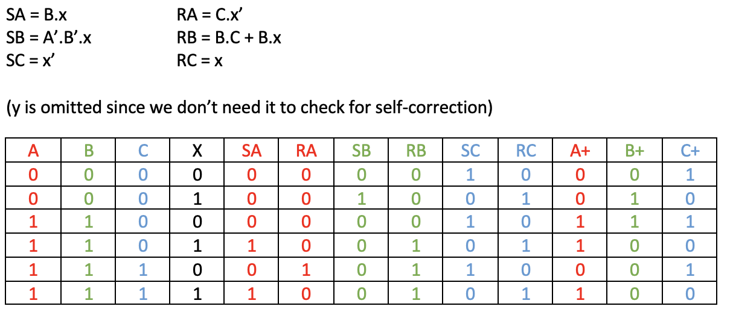
Self-Correcting Circuits (3/4)
Is Design Example III self-correcting?
We recreate the state table for the invalid states and see if they lead to any valid states:
Valid states: 1, 2, 3, 4, 5.
Invalid states: 0, 6, 7.

Slide 32
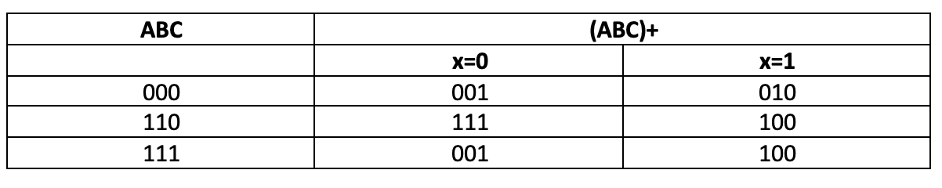
Self-Correcting Circuits (4/4)
Is Design Example III self-correcting?
The transitions for the invalid states is summarized below:
We can see that every invalid state eventually transits to some valid state, hence this circuit is self-correcting.
Valid states: 1, 2, 3, 4, 5.
Invalid states: 0, 6, 7.

Slide 33
quizzes

Slide 34
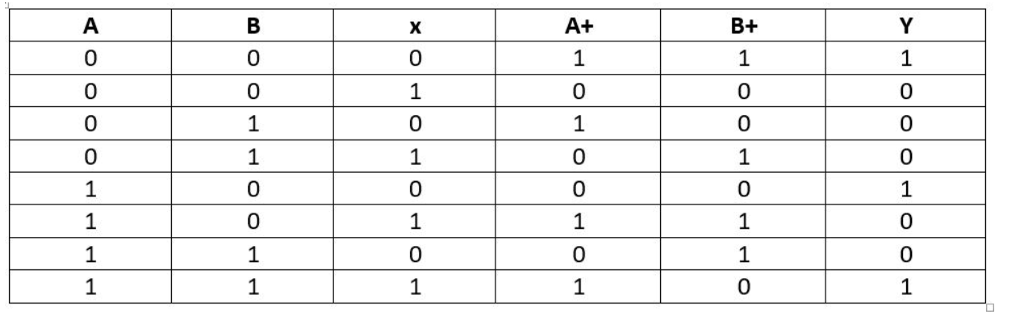
Lecture 19 Quiz 1
In this quiz we are given the following table:

Slide 35
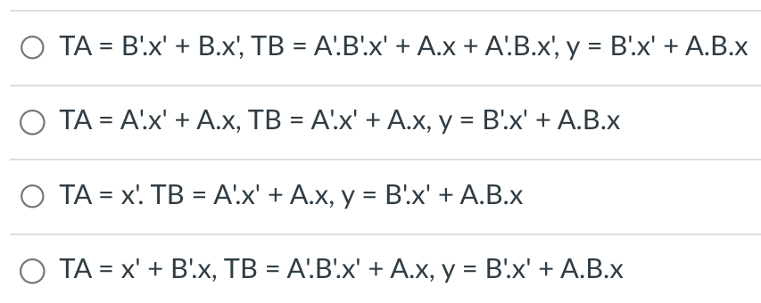
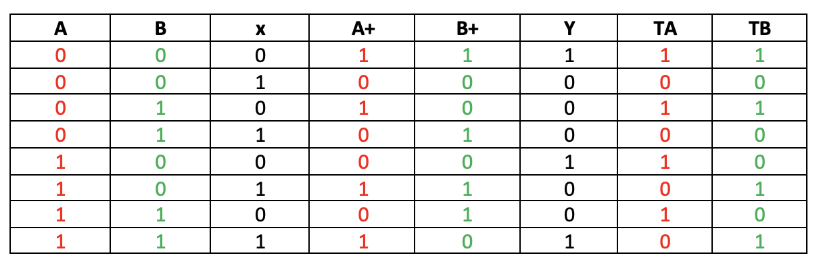
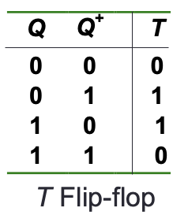
Lecture 19 Quiz 1 Question 1
Suppose we use T flip-flops (FFs) to implement the sequential circuit. Choose the most simplified FF input equations and sequential circuit output equations from below:
TA
B
1
0
0
1
A
1
0
0
1
x
TB
B
y
B
1
0
0
1
1
0
0
0
A
0
1
1
0
A
1
0
1
0
Augmented State Table:
x
x

Slide 36
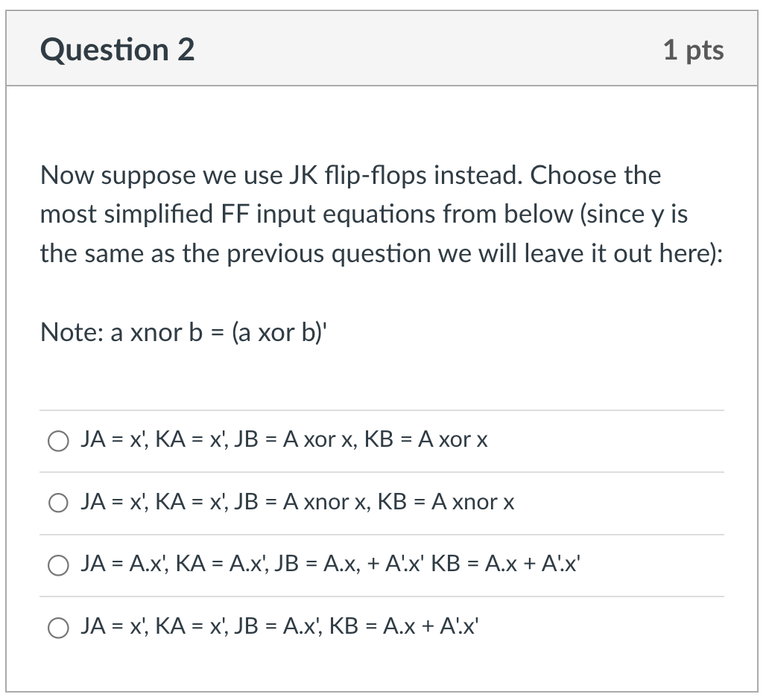
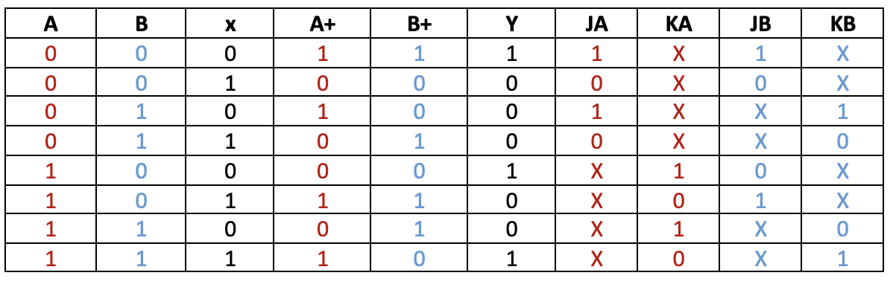
Lecture 19 Quiz 1 Question 2
Now suppose we use JK flip-flops instead. Choose the most simplified FF input equations from below:
(Note: a XNOR b = (a XOR b)’.
JA
B
KA
B
1
0
0
1
X
X
X
X
A
X
X
X
X
A
1
0
0
1
x
x
JB
B
KB
B
1
0
X
X
X
X
0
1
A
0
1
X
X
A
X
X
1
0
Augmented State Table:
x
x
JK Flip-flop

Slide 37
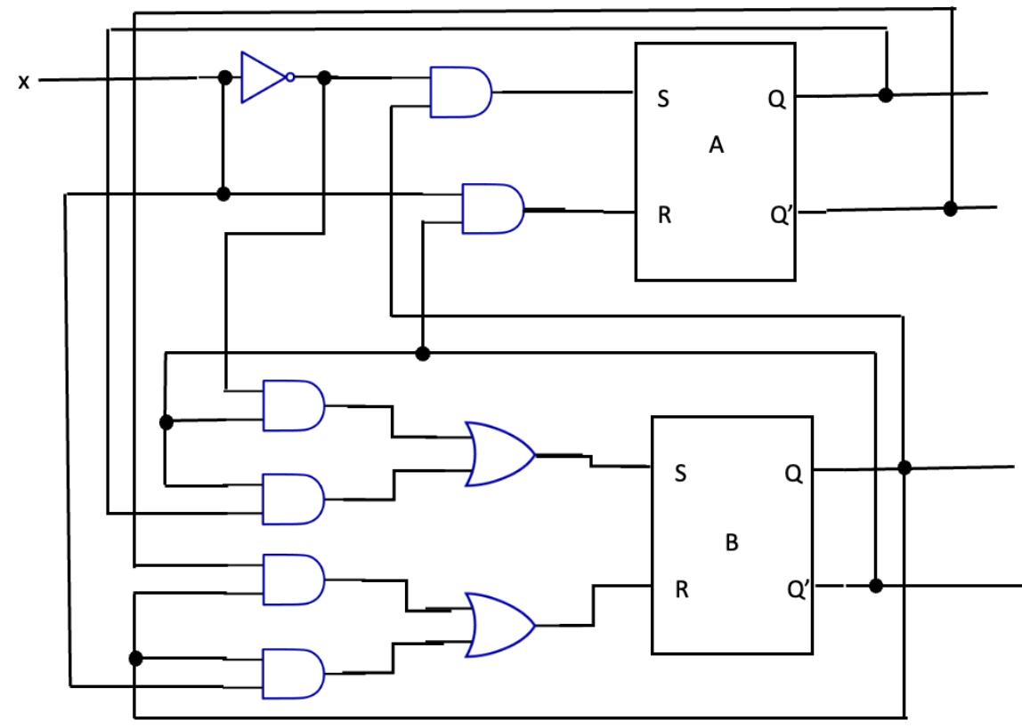
Lecture 19 Quiz 2
In this quiz we are given the following circuit:

Slide 38
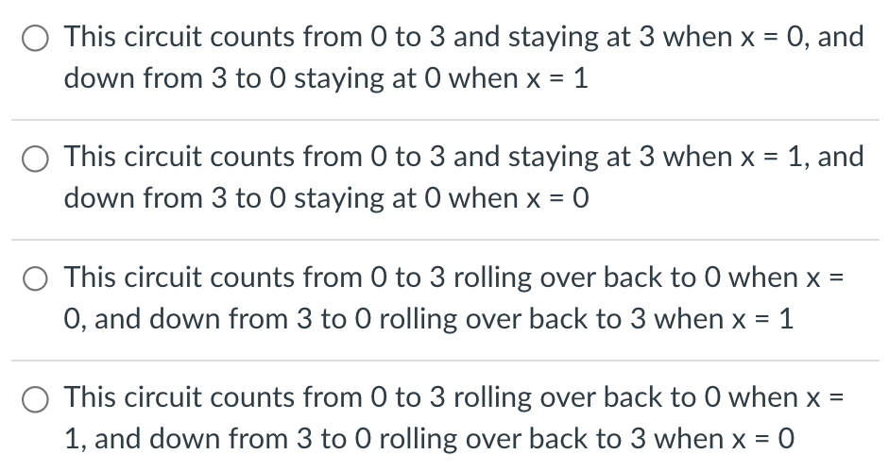
Lecture 19 Quiz 2 Question 1
Choose the statement that best describes this circuit:

Slide 39
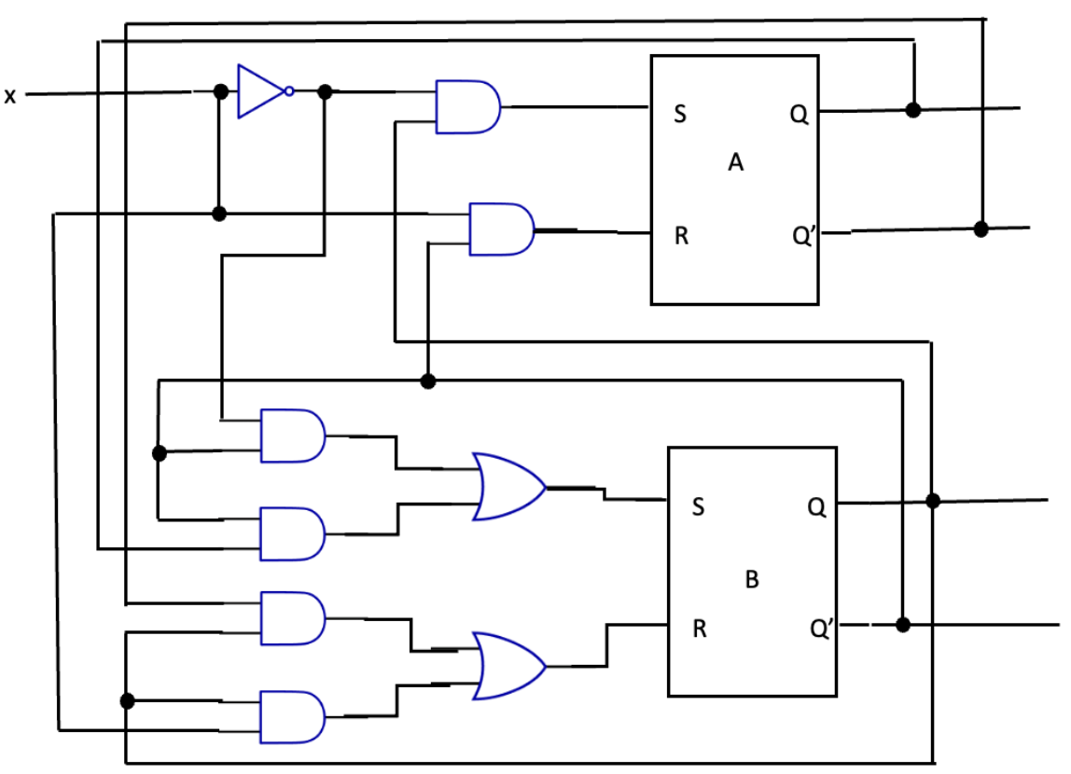
Lecture 19 Quiz 2 Question 1
x’
B·x’
A
B’·x
A’
B’·x’
B’·x’ + A·B’
A·B’
B
A’·B
A’·B + B·x
B’
B·x

Slide 40
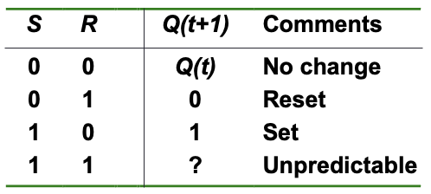
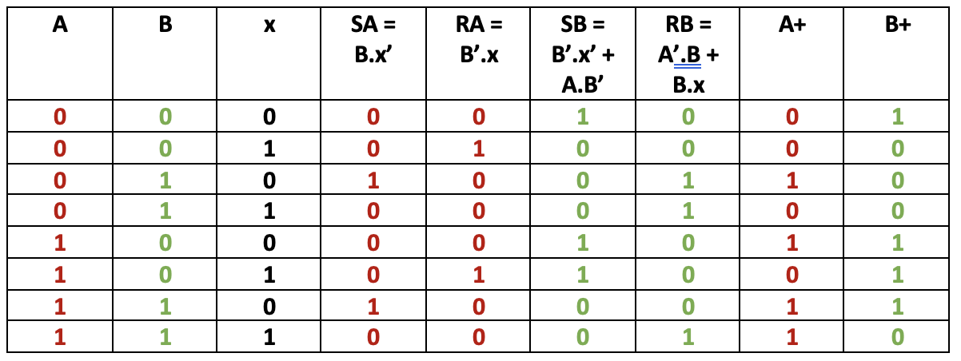
Lecture 19 Quiz 2 Question 1
State Table

Slide 41
Lecture 19 Quiz 2 Question 1
State Table
State Diagram
1
0
00
01
1
0
1
1
0
11
10
0

Slide 42
Lecture 19 Quiz 2 Question 1
State Diagram
1
0
00
01
Choose the statement that best describes this circuit:
1
0
1
1
0
11
10
0

Slide 43
Sli.do questions

Slide 44
Slido Questions
Q1: How does slide 9 of lect 19 work? Why is it that both R and S are high considered an invalid input?
A: It has been illustrated that when both R and S are high, the output Q and Q’ are the same, which violates the definition of a latch/flip-flop.
Q2: Does Q(t+1), Q+ and Q’ all mean the same thing?
A: Q(t) and Q(t+1) mean present state and next state respectively. They can also be referred to simply as Q and Q+ respectively. So, Q = Q(t), and Q+ = Q(t+1).
Q’ is the complement of Q. Therefore, Q’ is not the same as Q (in fact, it is the negation/opposite of Q), nor is it the same as Q+ (it has no relationship to Q+).
Q3: L19 slide 10, the outputs are redirected as inputs, and to get outputs we need inputs first. How does the whole thing work as it seems like a never-ending cycle.
A: If there isn’t a clock, will be a “never-ending cycle”. The clock provides synchronisation. The flip flop acts only when it is activated (by the rising edge or falling edge of the clock).

Slide 45
Slido Questions
Q4: Why is there a circle at Q’ output on the flip flop?
S
C
R
Q
Q'
D
C
Q
Q'
J
C
K
Q
Q'
Positive edge-triggered flip-flops
S
C
R
Q
Q'
D
C
Q
Q'
J
C
K
Q
Q'
Negative edge-triggered flip-flops
A: Just a labelling convention, to remind users that the output (Q’) is the negation of Q.

Slide 46
Slido Questions
Q5: What do Q and Q’ represent on the flip flop?
S
C
R
Q
Q'
D
C
Q
Q'
J
C
K
Q
Q'
Positive edge-triggered flip-flops
A: Q is the state of the flip-flop and Q’ is the negation of Q.
A flip-flop is a one-bit memory unit; when it stores a 0 it is said to be in the reset state; when it stores a 1 it is in the set state. The Q output of a flip-flop determines the state it is in.

Slide 47
Slido Questions
Q6: Under 6.2 of flip flop input functions (3/3), why does Q+ = DQ for a D flip flop?
A⁺ = A∙x + B∙x (since DA = A∙x + B∙x)
B⁺ = A'∙x (since DB = A'∙x)
x
D
Q
A
A: Because this is the characteristic table of a D flip-flop.
Q'
A'
D
Q
B
CP
Q'
B'
y
Figure 1

Slide 48
Slido Questions
Q7: In slide 17, how is JA=B and KA=B’?
From another student: How was KA=B’ derived? I don’t see a line connecting to B with a negation.
J
Q
A
J
Q
B
K
Q'
K
Q'
CP
y
x
Figure 3
A: The flip-flop on the left is A (i.e. its Q output is A); the flip-flop on the right is B (i.e. its Q output is B).
In the circuit diagram, JA is connected to B, hence JA=B. KA is connected to B’, hence KA=B’.

Slide 49
Slido Questions
Q8a: For flip flop in slide 20, is there a reason to choose either falling edge over rising edge for clock transition? Is this generally the case for all?
A: Rising-edge triggered and falling-edge triggered flip-flops basically work the same way. So there is no difference for our purpose.
Q8b: I understand a latch is for pulse (horizontal line) and a flip flop is for an edge (vertical line) but how do you know when to use which?
A: You will be told what to use. We will use flip-flops mostly.
Q8c: What’s the difference between latch and flip flop? Why are they named that way?
A: The difference has been explained in the recitation.
Q8d: Is there any point to gated S-R latch or is it used to explain gated D latch?
A: The point is to introduce the concept of an enable signal (which you have already seen under MSI components). This enable signal in a latch later becomes the rising/falling clock signal in a flip flop.
Q8e: When would we prefer to use J-K flip flop over T flip flop or D flip flop.
A: You will most likely be told which particular type(s) of flip flop to use. If you are given a choice, I will leave you to study the characteristics of these flip flops to find out which flip flop is better under what situation.

Slide 50
Slido Questions
Q9a: For stabilise part in pg 13, shouldn’t both of the NAND gate output their value simultaneously, in timestamp(31:16) why 2nd NAND gate take 0 as its input not 1 (edited).
Q9b: Can we use an XOR gate instead of a NAND gate for the enable? Page 13 of lecture #19.
A: No, XOR gate will not work. We want the circuit to be enabled when E=1 and disabled when E=0. Using an XOR gate, if you connect the input x and E to it, the output is x’.E + E’x; when E is 0, the output is x; when E is 1, the output is x’.
S
Q
S
EN
R
Q
Q'
EN
Q'
R

Slide 51
Slido Questions
Q10: Could you help us to bridge the gap between clocks used in sequential circuits and synchronisations of fetching instructions in MIPS and PC update?
Q11: Can we be sure that if we use the “don’t-care” terms to come up with flip flop input (use k-maps), we are guaranteed to create a self-correcting circuit?
A: No, there is no guarantee you will get a self-correcting circuit. We use K-maps to obtain the simplest SOP expressions. A self-correcting circuit is not determined by the simplicity of the expressions of the flip flop inputs.

Slide 52
Slido Questions
Q12a: For RAM, is it that the data input just has to be set within one clock cycle of the select line? (for write operation)
A: Yes.
Q12b: For memory arrays (in the last slide), why is it that the first 19 bits of address is sent to every one of the 512x8 chips?
A: Any one of the chips may be used, so the address has to be supplied to all of the chips.
Q12c: Are there 1000 bytes or 1024 bytes in 1 KB?
A: Unit of memory storage is in powers of 2. So 1KB = 2¹⁰ bytes = 1024 bytes, 1GB = 2²⁰ bytes = 1048576 bytes, etc.
Q12d: How do you know 12 bits is needed to address 4K?
A: 2¹² = 4096 = 4 * 1024 = 2² * 2¹⁰ = 4K.
Q12e: How can clock inputs be used to transfer data from multiplexer to demultiplexer over a single line?
A: The clock is used just to synchronise the transfer.

Slide 53
7.4 Memory Arrays (4/4)
Read/write control line not included in this diagram.
21-bit
A
addresses
19-bit internal chip address
A
0
1
A
19
A
20
2-bit
decoder
512K x 8 memory chip
512k X 8
memory chip
D
D
D
D
31-24
23-16
15-8
7-0
19-bit
address
8-bit data
input/output
2M × 32 memory module
Using 512K × 8 memory chips.
Chip select

Slide 54
Extra questions

Slide 55
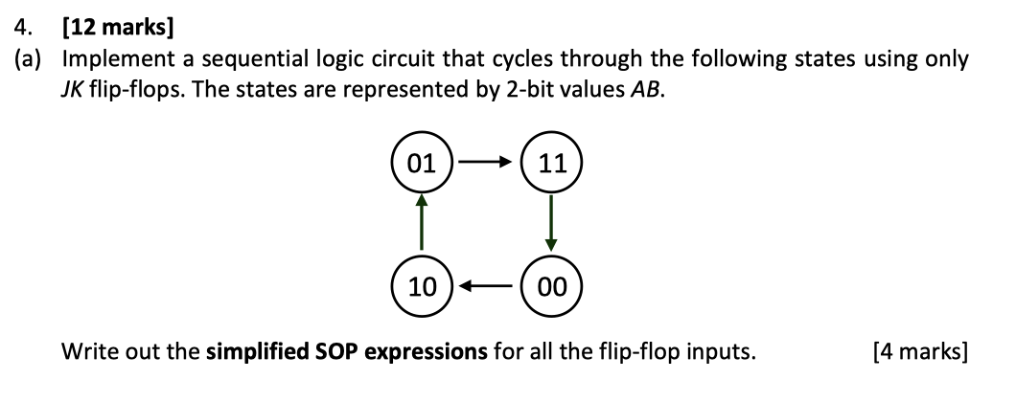
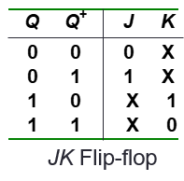
2019/20 Sem 2 Question 4
Present state |  | Next state |  | Flip-flop inputs
A | B | A+ | B+ | JA | KA | JB | KB
0 | 0 | 1 | 0
0 | 1 | 1 | 1
1 | 0 | 0 | 1
1 | 1 | 0 | 0
JA=1
1 X
1 X
X 1
X 1
0 X
X 0
1 X
X 1
KA=1
JB = A
KB = A

Slide 56
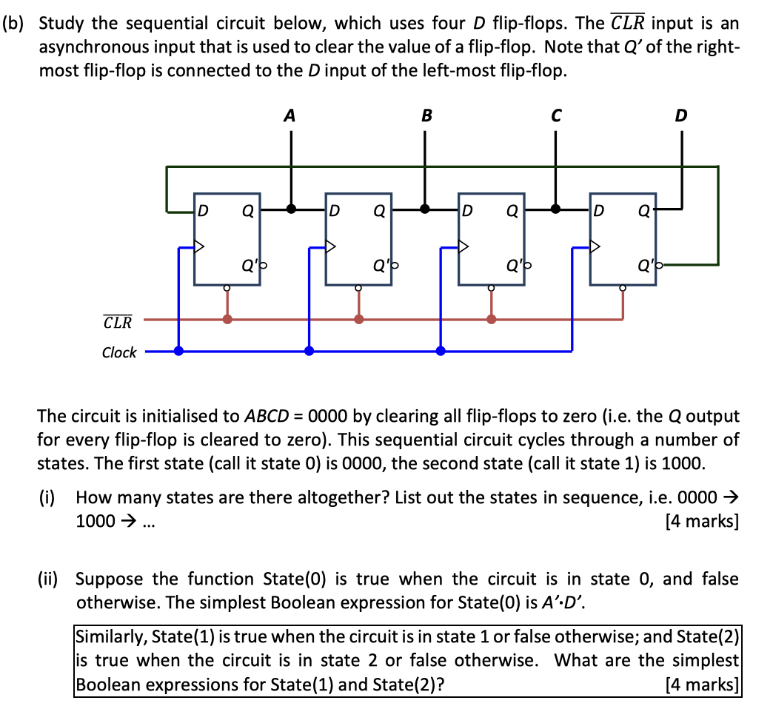
2019/20 Sem 2 Question 4

Slide 57
2019/20 Sem 2 Question 4
8 states:
0000 →
1000 →
1100 →
1110 →
1111 →
0111 →
0011 →
0001 →
back to 0000 and recycle
Observation:
For all of the states we have a “boundary” where the string of 1’s end and the string of 0’s begin, or where the string of 0’s end and the string of 1’s begin. Thus we only need to test the bits at the boundary for each state.
State 1: 1000
Boundary is at A and B.
State(1) = A.B’
State 2: 1100
Boundary is at B and C.
State(2) = B.C’

Slide 58
End of File

